Slide 1

Is SHACL Suitable for Data Quality Assessment?
Carolina Cortés ^{*1}, Lisa Ehrlinger ^{*1}, Lorena Etcheverry ^{*2} and Felix Naumann ^{*1}
^{*1} Hasso Plattner Institute, University of Potsdam
^{*2} Facultad de Ingeniería, Universidad de la República

Slide 2
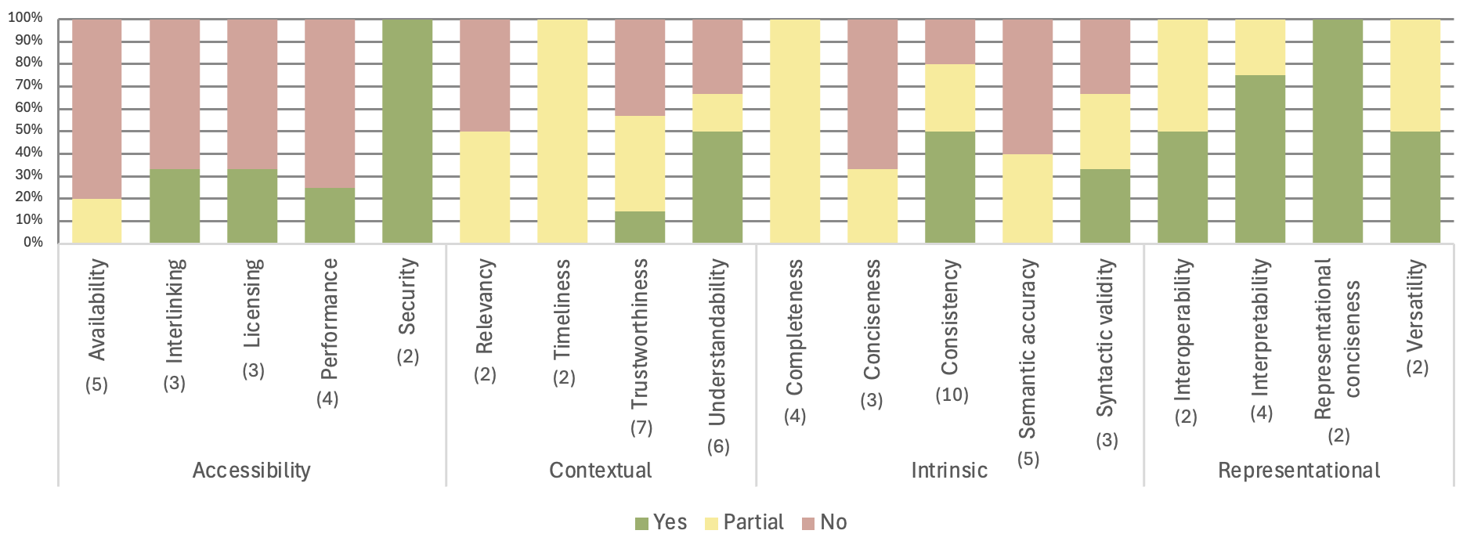
Is SHACL Suitable for Data Quality Assessment?
Metric coverage across all dimensions:
No = 25 (36%)
Partial = 22 (32%)
Yes = 22 (32%)
Notes:
To evaluate whether SHACL is suitable for DQA, we defined shapes for 69 metrics across 18 dimensions, and this is what we found.
36% of metrics cannot be covered at all
32% of metrics can be partially covered, so this means that for some aspects we were able to define shapes, and for others we weren’t
The remaining 32% of metrics can be fully covered.
Now I’m gonna give a brief introduction to the topic and then explain the approach that led us to these results.

Slide 3
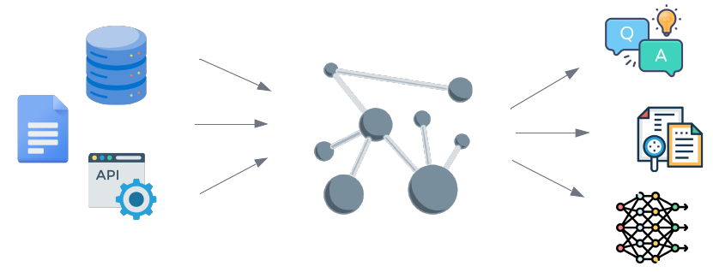
Data Quality is important in Knowledge Graphs
Notes:
Why is DQ important in KGs?
Well, KGs are built from diverse sources using automated, semi-automated, or manual methods.
This heterogeneous construction can introduce inconsistencies and errors, making data quality essential for AI applications like question answering and information retrieval, which rely on these graphs as input.

Slide 4

Data Quality
Data Quality (DQ) is generally defined as “fitness for use”.
Evaluated across different dimensions (e.g., Completeness and Consistency), which can be quantified using metrics.
Data Quality Assessment (DQA) - process of obtaining measures that characterize different aspects of DQ.
Notes:
Data quality (DQ) is generally defined as “fitness for use”, which highlights the importance of considering the context in which the data is used when assessing its quality.
DQ is typically evaluated across various dimensions, such as Completeness and consistency, and these dimensions can be quantified using metrics, which measure different aspects of each dimension.
Data quality assessment (DQA) is the process of obtaining measures, that characterize different aspects of DQ
NOTE: Merge with previous one

Slide 5
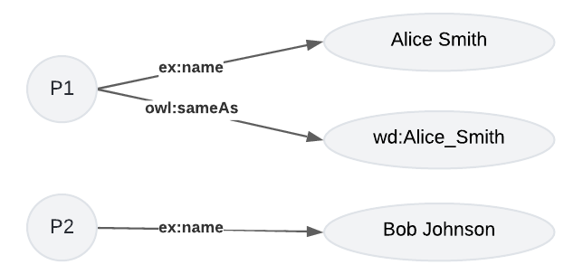
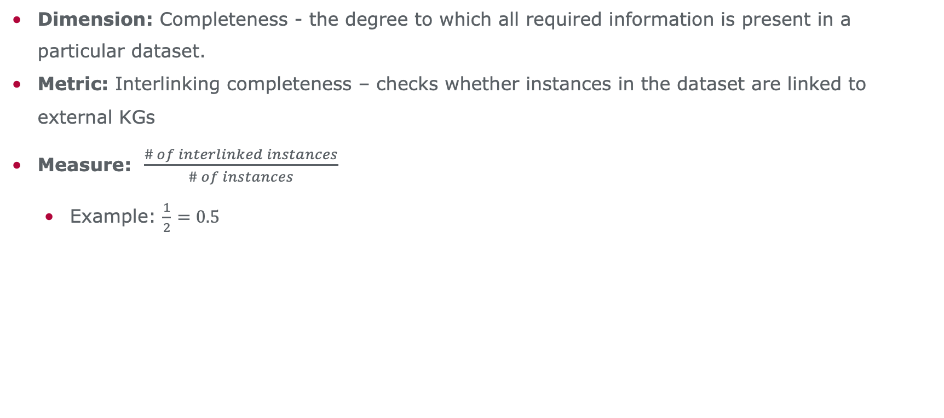
Data Quality
Dimension: Completeness - the degree to which all required information is present in a particular dataset.
Metric: Interlinking completeness – checks whether instances in the dataset are linked to external KGs
Measure: $\frac{\# of interlinked instances}{\# of instances}$
Example: $\frac{1}{2}$ $=0.5$
Notes:
An example of Dimension is Completeness and a metric for this dimension can be Interlinking completeness, which checks if instances in the dataset are interlinked.
For this metric, a DQ measure can be the ratio: number of interlinked instances / total number of instances
So for a graph like the one we see on the slide, the DQ measure for Interlinking completeness would be 0.5, since there are 2 instances and only one of them is interlinked to another one via the owl:sameAs property

Slide 6
DQ Assessment in Knowledge Graphs
High-level approaches:
Metric definitions [Zaveri et al. (2012), Issa et al. (2021)]
Conceptual frameworks with no concrete implementation [Nayak et al. (2021), Chen et al. (2019)].
Bottom-up approaches:
SPARQL queries (ad-hoc) [Debattista et al. (2016), Kontokostas et al. (2014), Pellegrino et al. (2024), Fürber et al. (2011)].
Constraint languages:
RDF Schema
Shapes Constraint Language (SHACL)/Shape Expressions Language (ShEx)
RDF validation through the specification of constraints as shapes.
Notes:
Several works address the quality of KGs from a high-level perspective, either presenting definitions and metrics or conceptual frameworks to assess the quality of KGs without a concrete implementation.
Other works approach the topic of KG quality from a bottom-up perspective, by developing tools to assess DQ, and generally most of these works define ad-hoc SPARQL queries to obtain measures for DQ dimensions.
Since the inception of the semantic web, Constraint Languages were created, starting with RDF schema. And more recently SHACL and ShEx were introduced, which enable RDF validation by enabling the specification of constraints as shapes.
The difference between this last 2 and RDF schema is that they provide a structured validation report, showing information about the violations.

Slide 7
Research gap
Most works on constraint languages (SHACL, ShEx) focus on shape generation from data/metadata [Spahiu et al. (2018), Rabbani et al. (2023), Boneva et al. (2019), Cimmino et al. (2020), Pandit et al. (2018), Duan et al. (2024), Fernandez-Álvarez et al. (2022)].
Few works link shape generation to DQ assessment and improvement [Spahiu et al. (2018), Rabbani et al. (2023), Yang et al. (2023), Luthfi et al. (2022)].
Existing attempts only target specific dimensions (e.g., Completeness [Luthfi et al. (2022)]).
Contributions
Evaluate the suitability of SHACL core for DQA by defining shapes for the set of 69 DQ metrics defined by Zaveri et al. (2012).
Prototype that automatically instantiates the defined shapes and computes DQ measures based on the shape validation results.
Notes:
Since these constraint languages were introduced, different works have focused on the generation of shapes, either from the data or its metadata (e.g., ontologies).
And only some works attempt to bridge the gap between the generation of shapes and their potential to assess and improve the quality of the data.
In particular, the work by Luthfi et al. considers the concept of DQ from the dimensions perspective, defining shapes for Completeness.
So, our work explored how SHACL core can be leveraged for DQA. In particular, we evaluated the suitability of SHACL core for DQA by defining shapes for a set of 69 DQ metrics defined in the survey by Zaveri et al.
And we also developed a prototype that automatically instantiates the defined shapes and computes DQ measures from the validation results

Slide 8
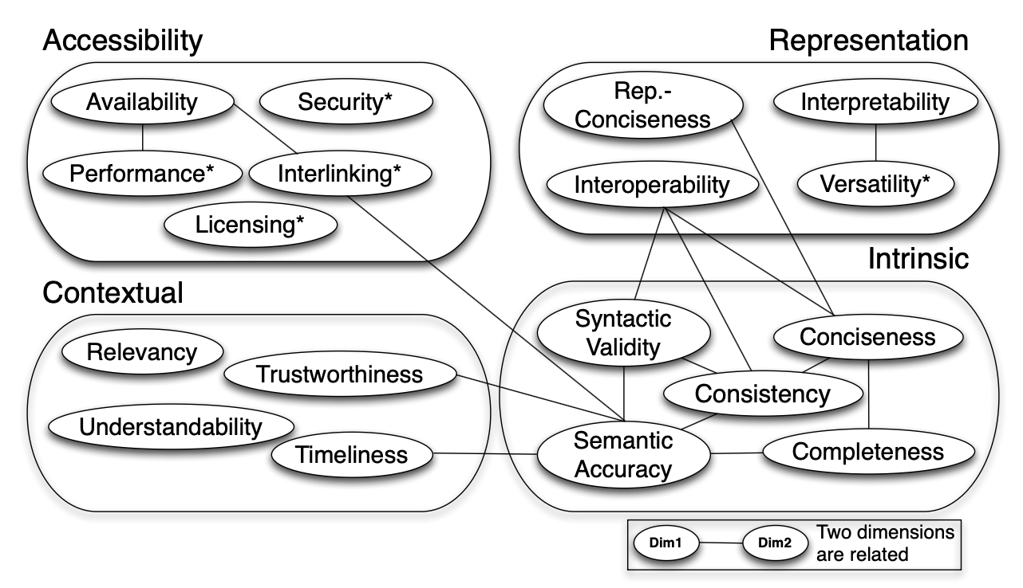
Approach
We followed Zaveri et al. (2012) groups of dimensions and metric definitions.
18 dimensions (4 groups)
69 metrics
For each metric we defined a SHACL shape or explained SHACL's limitation when shapes cannot be defined.
Focus on SHACL core.
Zaveri, A., Rula, A., Maurino, A., Pietrobon, R., Lehmann, J., & Auer, S. (2012). Quality assessment for Linked Data: A Survey: A systematic literature review and conceptual framework. Semantic web, 7(1),63-93.
Notes:
This paper builds on the comprehensive DQ metrics survey by Zaveri et al.
This work is a systematic literature review, which identified 18 dimensions, grouped into 4 categories and 69 metrics, for Linked Data Quality Assessment.
In our approach, we follow their structure, defining SHACL core shapes for each metric or explaining SHACL core’s limitations when shapes cannot be defined.

Slide 9
SHACL flavor
Shape Constraint Language (SHACL) - W3C standard:
SHACL core
SHACL-SPARQL – embed SPARQL queries in SHACL shapes.
Non-standard extensions (rely on SPARQL):
Data Shapes Vocabulary (DASH) and SHACL Advanced Features.
Why focus on SHACL core?
Prior studies that use SHACL for Data Quality rely only on SHACL core components.
SHACL-SPARQL performance depends on the underlying query engine optimizations.
SHACL-SPARQL leads to ad-hoc queries, losing the benefit of formal, language-independent constraints that SHACL core provides.
Notes:
The SHACL language consists of two main components: SHACL core and SHACL-SPARQL, which mainly consists of embedding SPARQL queries in SHACL shapes.
Additionally, there exist non-standard SHACL extensions such as the DASH Data Shapes Vocabulary and SHACL Advanced Features, all of which rely heavily on SPARQL.
We chose to restrict our shapes to only use SHACL core components for several reasons:
1. Prior studies that use SHACL for Data Quality rely only on SHACL core components and one of the goals of our approach was to test their assumption that SHACL can be used for assessing and improving the quality of your data
2. Moreover, SHACL can be implemented in various programming languages, each with its own optimizations, and once SPARQL-based constraints are used, performance depends on the underlying query engine.
3. As soon as you move onto SHACL-SPARQL you end up defining ad-hoc SPARQL queries, losing the ability to define formal constraints, without being tied to a specific language, which is what SHACL core allows.

Slide 10
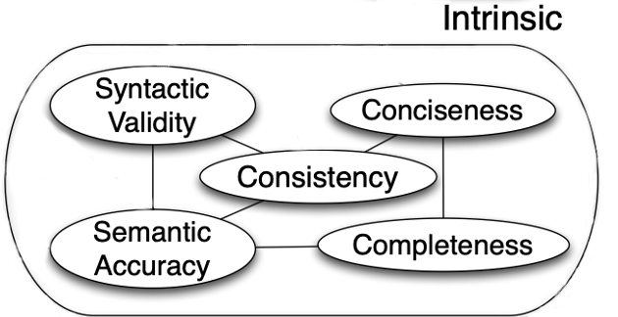
SHACL for DQA – Intrinsic group
Intrinsic dimensions: independent of the user’s context, and assess whether data accurately (syntactically and semantically), compactly, and completely represents the real world, and whether it is logically consistent.
Zaveri et al. (2012)
Notes:
To exemplify our approach, I chose the Intrinsic group of dimensions, which consists of dimensions that are independent of the user’s context, and assess whether data accurately, compactly, and completely represent the real world, and whether the data is logically consistent

Slide 11
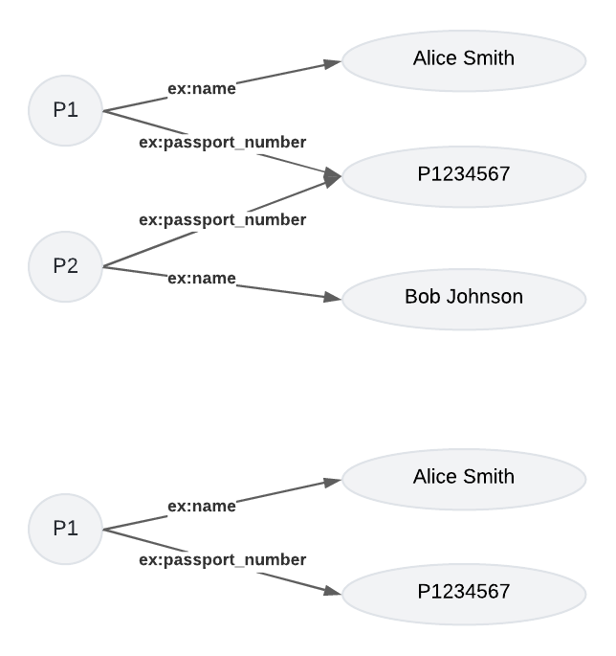
SHACL for DQA – Consistency
Consistency: a KG contains no (logical or formal) contradictions according to its knowledge representation and inference mechanisms [Zaveri et al. (2012)].
Metric: Check the correct usage of an inverse-functional property.
Notes:
From this group, I considered the dimension Consistency, which according to Zaveri et al. means that a knowledge base contains no (logical or formal) contradictions according to its knowledge representation and inference mechanisms.
For this dimension, the survey identified 10 metrics, from which I chose the one that checks the correct use of inverse-functional properties.
An inverse-functional property resembles the notion of key in relational databases For example, the passport number of a person can be modeled as an InverseFunctionalProperty, since it identifies exactly 1 person.

Slide 12
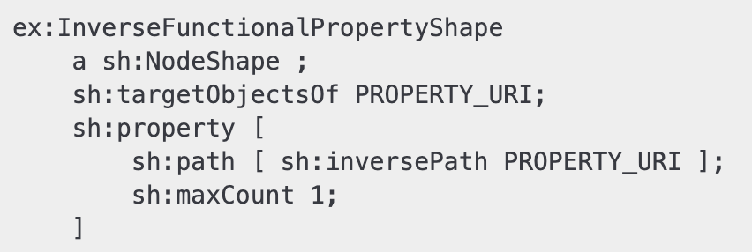
SHACL for DQA – Consistency
Consistency: a KG contains no (logical or formal) contradictions according to its knowledge representation and inference mechanisms [Zaveri et al. (2012)].
Metric: Check the correct usage of an inverse-functional property.
each object
incoming link
only one
Notes:
So, to check the correct usage of an inverse-functional property, we defined a SHACL shape that verifies that each object has only one incoming link.

Slide 13
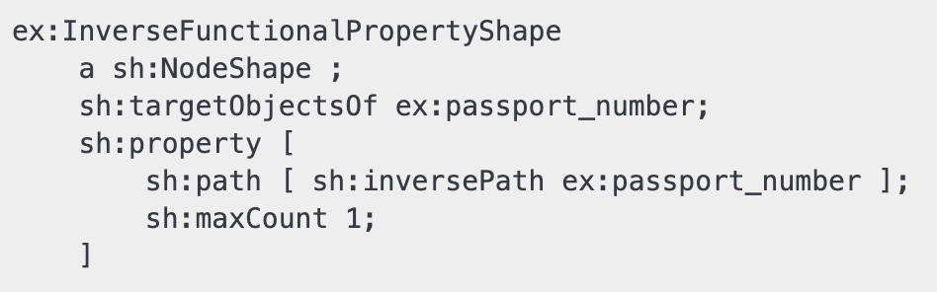
SHACL for DQA – Consistency
Consistency: a KG contains no (logical or formal) contradictions according to its knowledge representation and inference mechanisms [Zaveri et al. (2012)].
Metric: Check the correct usage of an inverse-functional property.
Notes:
Suppose we had a graph like this one, since the passport object has 2 incoming links, it will be outputted in the validation report for this shape

Slide 14
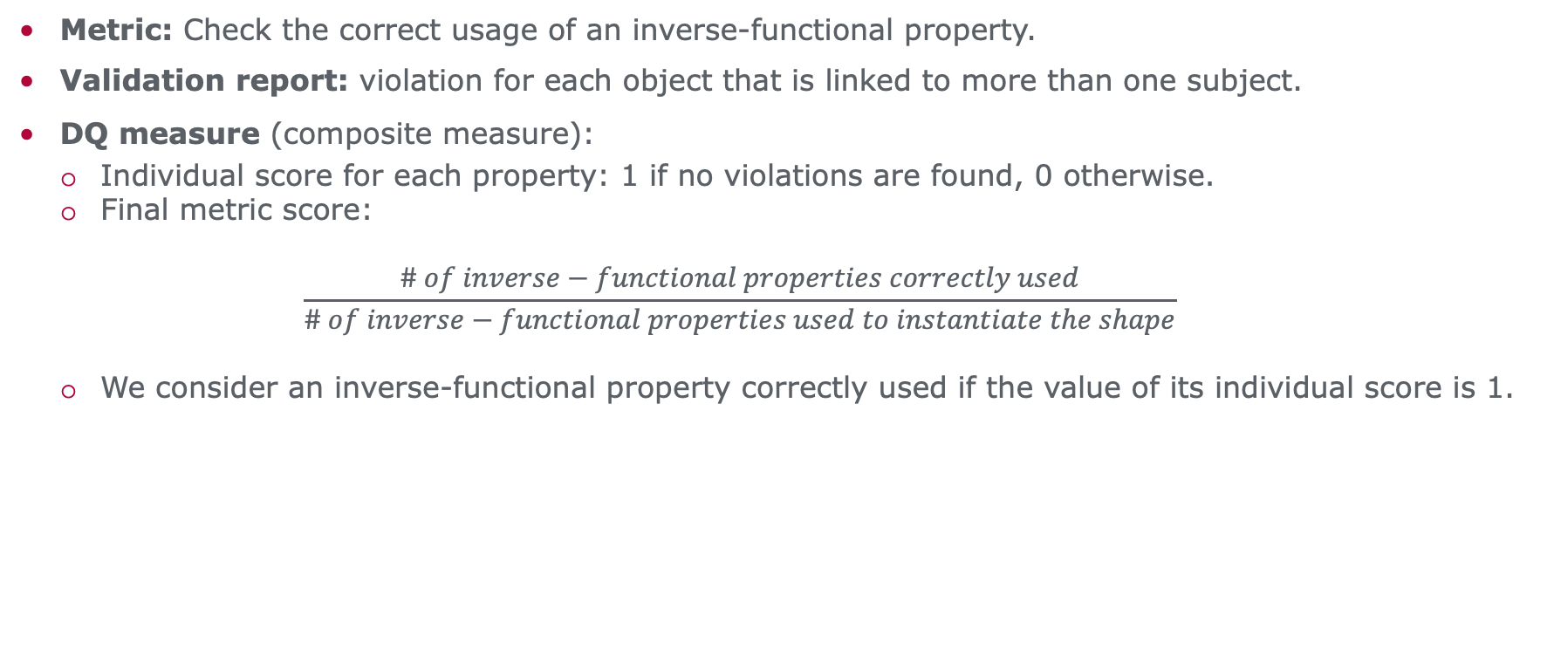
SHACL for DQA – Consistency
Metric: Check the correct usage of an inverse-functional property.
Validation report: violation for each object that is linked to more than one subject.
DQ measure (composite measure):
Individual score for each property: 1 if no violations are found, 0 otherwise.
Final metric score:
$$\frac{\# of inverse−functional properties correctly used}{\# of inverse−functional properties used to instantiate the shape}$$
We consider an inverse-functional property correctly used if the value of its individual score is 1.
Notes:
Since this shape depends on a specific inverse functional property, to get a measure value, we first calculate an individual score per property: 1 if there are no violations and 0 otherwise, and then we to get the final measure we aggregate the scores for all properties by calculating the number of inverse-functional properties correctly used to the total amount of inverse-functional properties that were used to instantiate the shape. And here we consider an inverse-functional property as correctly used if its individual score was 1
Note:
extende the text box

Slide 15
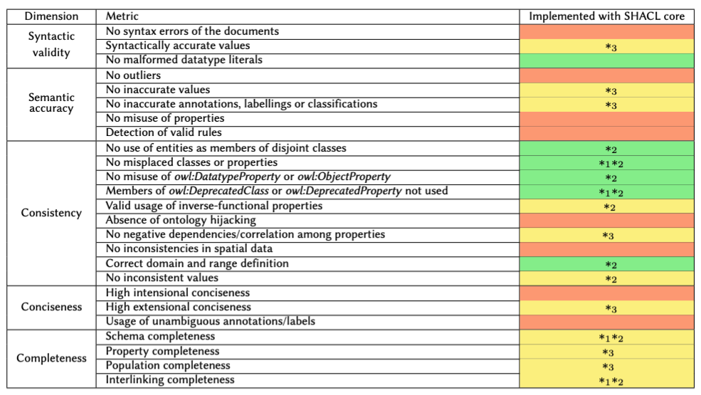
Intrinsic group
Notes:
Here we can see the result of our study for a single group of dimensions, where we marked with green the metrics for which we could define a SHACL shape, with yellow those that can be partially covered, and with red the ones that can’t be covered at all.
For example, for the dimension Semantic Accuracy we can see that the metric No inaccurate values can be partially covered, since it checks 3 aspects: whether functional dependencies hold in the data, by comparing literal values of a resource, or via crowd-sourcing. This metric is partially covered, since checking FDs and doing crowd-sourcing cannot be accomplished with shacl core
On the other hand, for the dimension Consistency, the metric that verifies that entities aren’t members of disjoint classes can be fully covered, since we defined a shape that verifies this and outputs entities that are instances of disjoint classes as violations.
Lastly, for the dimension Conciseness we can see a case of a metric that cannot be covered at all with SHACL core, which is the metric “Usage of unambiguous annotations/labels”, since recognizing ambiguous annotations requires understanding their semantics.
8 n
6 y
11 p

Slide 16
Assumptions
(A1) All entities are explicitly typed.
(A2) The ontology is sufficiently defined.
(A3) Relevant domain knowledge is available for shape instantiation.
Notes:
Now, for the definition of the shapes we made the following assumptions:
All entities are explicitly typed
The ontology is sufficiently defined
Relevant domain knowledge is available for shape instantiation.

Slide 17
Assumptions
Violation → untyped instances are excluded from validation.
(A1) All entities are explicitly typed.
(A2) The ontology is sufficiently defined.
(A3) Relevant domain knowledge is available for shape instantiation.
Violation → schema characteristics cannot be checked.
Notes:
If the first assumption is not satisfied, then untyped instances won’t be checked
If the second assumption is not satisfied, then schema characteristics, such as range, domain, or property constraints, cannot be checked.

Slide 18
Assumptions
Violation → untyped instances are excluded from validation.
(A1) All entities are explicitly typed.
(A2) The ontology is sufficiently defined.
(A3) Relevant domain knowledge is available for shape instantiation.
Violation → schema characteristics cannot be checked.
Possible Relaxations
For (A2):
Mine schema characteristics automatically.
Profiling statistics to approximate range/domain constraints.
Notes:
For (A2), a possible relaxation could be to mine these schema characteristics automatically or leverage profiling statistics to approximate range and domain information, which would enable the construction of an initial ontology

Slide 19
Assumptions
Violation → untyped instances are excluded from validation.
(A1) All entities are explicitly typed.
(A2) The ontology is sufficiently defined.
(A3) Relevant domain knowledge is available for shape instantiation.
Violation → schema characteristics cannot be checked.
Violation → inherently limits assessment.
Notes:
The last assumption is inherent to DQA, as some quality dimensions rely on domain knowledge, limiting their assessment.

Slide 20
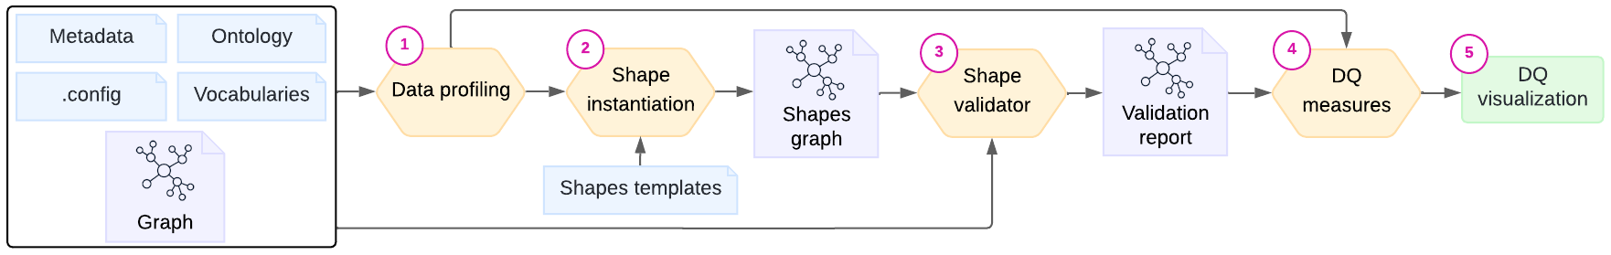
Prototype
Built using Python libraries (rdflib, PySHACL, streamlit).
Process:
(1) Profiling to extract info from graph, ontology or vocabularies.
(2) Shape instantiation from shape templates.
(3) Shape validation.
(4) Measure calculation from validation results.
(5) DQ visualization.
Notes:
Once we defined all the shapes, we developed a prototype, using Python libraries, to test our approach.
The prototype receives as input a graph (instances), ontology, metadata file, and config file.
Then it goes through a profiling stage where we extract information from the graph, ontology, and vocabularies for shape instantiation and metric calculation.
After that we perform shape instantiation.
This step considers the SHACL shapes we defined, which we store as reusable templates with variables, and replaces these variables with the corresponding value, extracted either from the profiling stage or the configuration file.

Slide 21
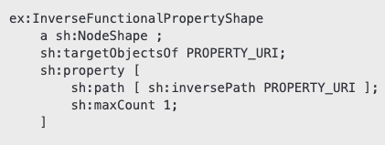
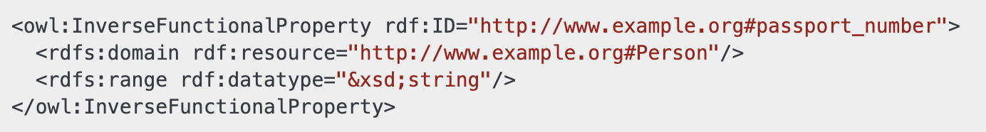
Prototype – Shape instantiation
Shape template:
Instantiated shape:
OWL ontology:
Notes:
For example, if we consider the shape that checks the correct usage of inverse-functional properties, this shape is stored with variables that are replaced with inverse-functional properties defined in the vocabulary or ontology used by the dataset.

Slide 22
Prototype
Built using Python libraries (rdflib, PySHACL, streamlit).
Process:
(1) Profiling to extract info from graph, ontology or vocabularies.
(2) Shape instantiation from shape templates.
(3) Shape validation.
(4) Measure calculation from validation results.
(5) DQ visualization.
Notes:
Then we use existing validators to check shapes against the data graph, ontology,or metadata.
And after that we compute DQ metrics from validation results and store them in a CSV file.
Finally, the results can be visualized in a dashboard.

Slide 23
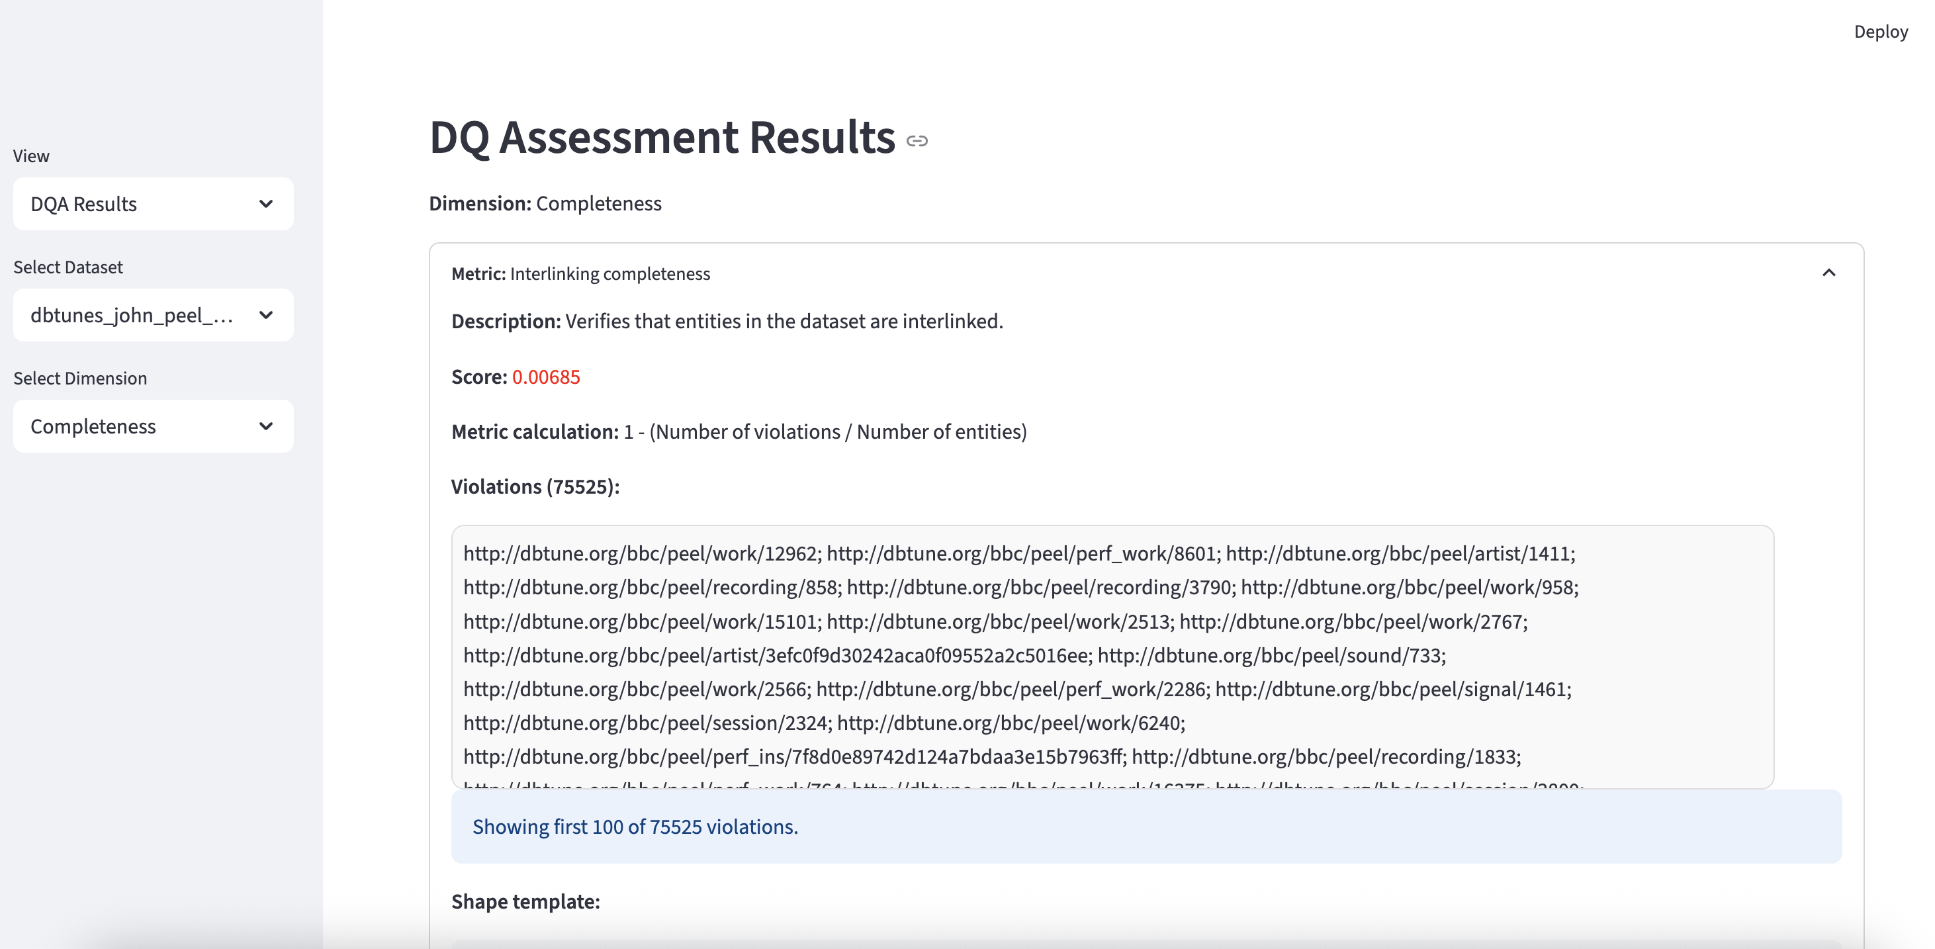

Prototype
Datasets: Temples of the Classical World, DBTunes - John Peel Sessions, Drugbank
Validation time ranged from 40 seconds to 3 hours.
Code
Notes:
We tested our prototype on 3 different datasets obtained from the LOD cloud.
Validation time ranged from 40 seconds to 3 hours for 500-740 instantiated shapes. The time and number of shapes depends on the dataset since the smallest dataset had around 1300 instances, while the biggest one had around 300,000 instances
Here we can see an image of what the dashboard looks like, so for a specific dataset we can see the DQA results for each dimension and metric, for those that we defined shapes, and we also output the violations.

Slide 24
Strengths of SHACL core for DQA
Syntactic validation: Checking patterns, datatypes, and whether values fall within specified ranges or lists.
Consistency verification: Ensuring alignment between data and vocabulary or ontology definitions (e.g., correct use of a property’s domain or range).
Linked data best practice validation: Checking compliance with Linked Data publishing guidelines (e.g., use of hash URIs for entities and existence of labels in resources).
Structural validation: Ensuring class instances follow the expected structure, including required properties and basic constraints.
Suitable for Syntactic Validity, Interpretability, Security, Representational Conciseness, and specific aspects of Consistency, Versatility, and Understandability.
Notes:
From our evaluation, we were able to identify the strengths of SHACL core for DQA.
For example, it is useful for
syntactic validation, such as checking patterns, datatypes, and whether values fall within specified ranges or lists.
It is also useful to verify consistency between the data and vocabularies or ontologies used (for example, by verifying the correct use of a property’s domain or range).
It can also be used to verify if data supports linked data best practice, such as the use of hash URIs for entities and existence of labels in resources, among other things.
Lastly, it can be used to validate property characteristics, such as irreflexive, functional, asymmetric, or inverse-functional
And it is also useful for structural validation, such as ensuring class instances follow the expected structure, including required properties and basic constraints

Slide 25
Limitations of SHACL core for DQA
No External Access — unsuitable for Availability and Performance
Node-Centric Scope — unsuitable for Interlinking (covered by SHACL-SPARQL)
No cross-entity comparison — unsuitable for Semantic Accuracy and Conciseness (covered by SHACL-SPARQL)
No arithmetic or Dynamic expressions — unsuitable for Timeliness (covered by SHACL-SPARQL)
Limited Semantic Awareness — unsuitable for Semantic Accuracy, Understandability, and Versatility
Restricted Targeting Mechanism — (covered by SHACL-SPARQL)
Notes:
However, its applicability to data quality assessment is still limited in several ways:
Since SHACL operates only on RDF graphs, it cannot access external resources or perform system-level checks.
Moreover, it validates only individual nodes and their immediate property values, so it’s unsuitable for Interlinking, which requires computing network-level measures
It also lacks mechanisms to compare property values across different entities in the graph
It also doesn’t provide a way of computing arithmetic or dynamic expressions
Also lacks mechanisms to verify semantic aspects of the data
Lastly, it only provides a small set of predefined target types, which is unsuitable for metrics that need to verify things over arbitrary triples

Slide 26



Conclusion
Assessed the suitability of SHACL for DQA by defining shapes for the 69 data quality metrics.
Metric coverage: 36% not covered, 32% partially covered, 32% fully covered
Developed prototype to automatically instantiate the defined shapes.
Identified SHACL core's strengths and limitations.
Future work:
Consider new dimensions and metrics (e.g., bias) not addressed by the survey.
Data Quality Assessment goes beyond checking constraints.
Hybrid approaches combining SHACL constraint checks with tools to access external resources and evaluate semantic aspects of the data.
Paper Extended Version
Code
Page
Notes:
Our takeaway from this evaluation is that, even though some of SHACL core’s limitations can be addressed using SHACL-SPARQL, SHACL still lacks the ability to access external resources, evaluate semantic aspects of the data and perform system level checks. Given that DQA goes beyond just checking constraints, future work should be focused on developing hybrid approaches combining SHACL’s capabilities with other techniques that can overcome its limitations. Lastly, we would also like to look at other dimensions that have arised over the years that weren’t considered in this survey.

Slide 27
Appendix

Slide 28
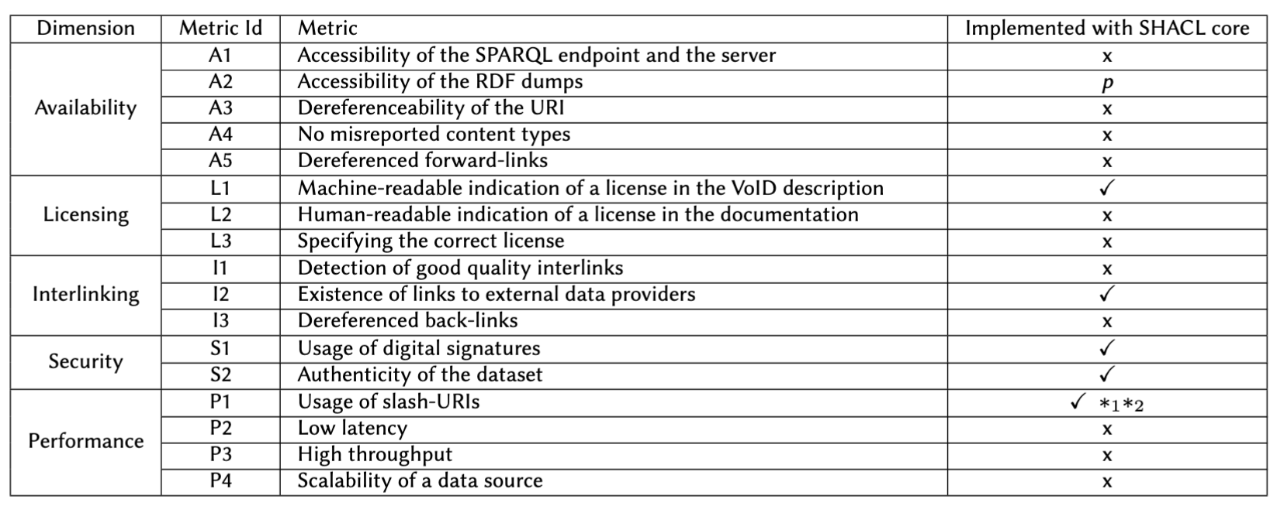
Accessibility group
Notes:
11 no
1 p
5 y

Slide 29
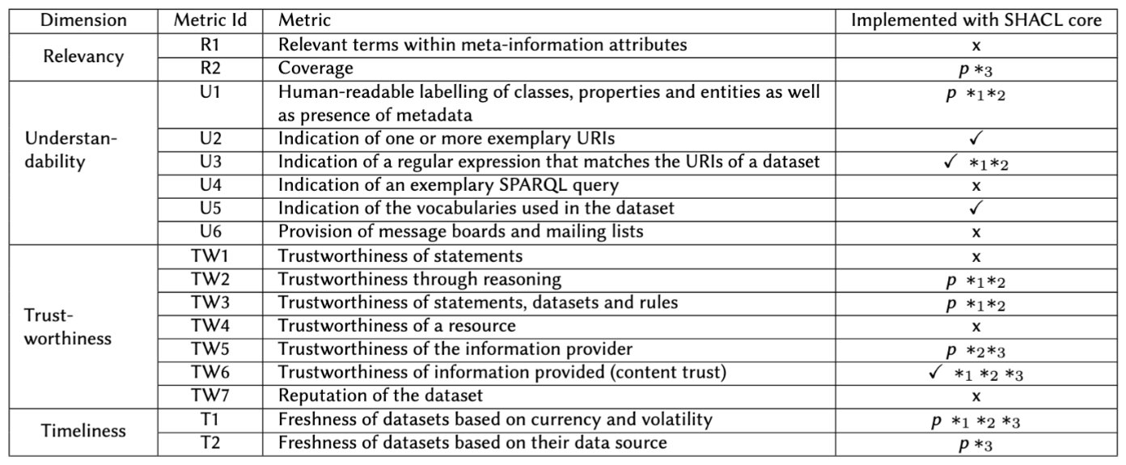
Contextual group
Notes:
6 n
7 p
4 y

Slide 30
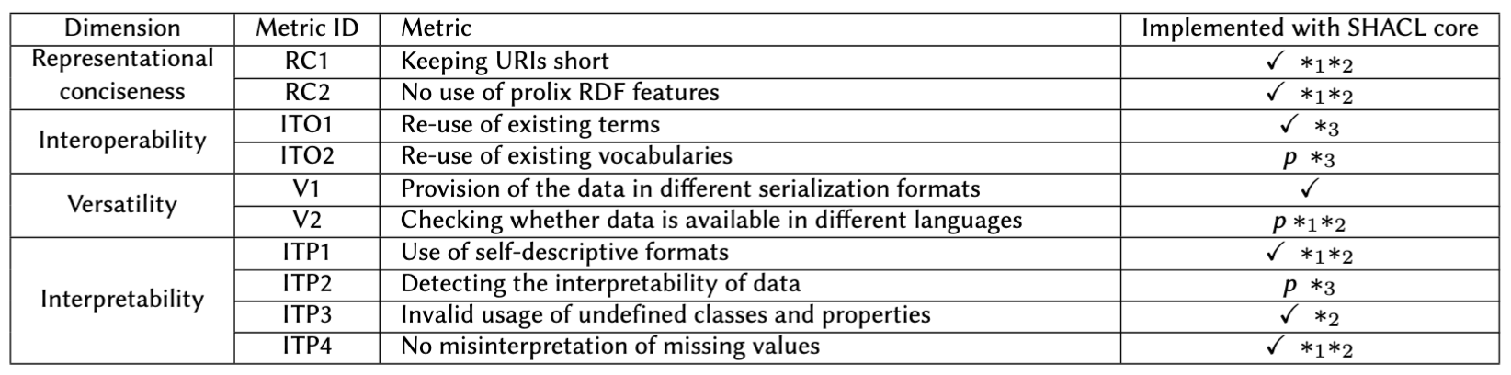
Representational group
Notes:
7 y
3 p

